Slide 1
Updating Tobacco Policy: How [CITY/COUNTY] Can Protect Youth and Improve Health
Presented by: [PRESENTER, CREDENTIALS] | Contact: [EMAIL]
[AFFILIATED ORGANIZATION(S)] | Last updated: 9.9.20
Notes:
local governments have used their authority to enact tobacco control policies to protect communities from tobacco-related harms and youth tobacco initiation

Slide 2
Overview
Data on tobacco use
Key policy changes
Including e-cigarettes in Clean Indoor Air Laws
Adapting to Tobacco 21
Enforcement
Prevention and Cessation

Slide 3
Tobacco Use
Nationally and in [CITY OR County]

Slide 4
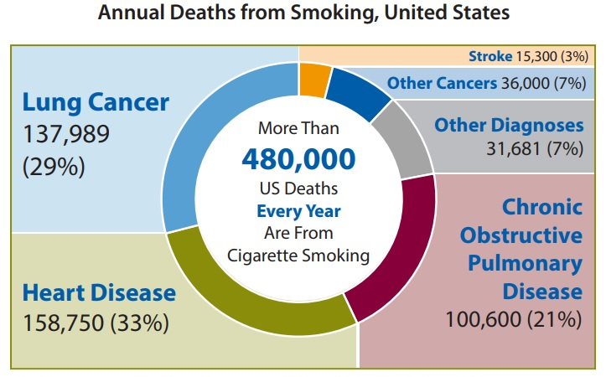
Tobacco is the #1 cause of early death in the United States
Notes:
To start, it is important to note tobacco is the number 1 cause of early death in the United States. Cigarette smoking is destructive to the body, causing conditions such as cancer, heart and lung disease.
Sources:
https://www.cdc.gov/tobacco/data_statistics/fact_sheets/health_effects/tobacco_related_mortality/index.htm
https://www.cdc.gov/tobacco/infographics/health-effects/index.htm

Slide 5
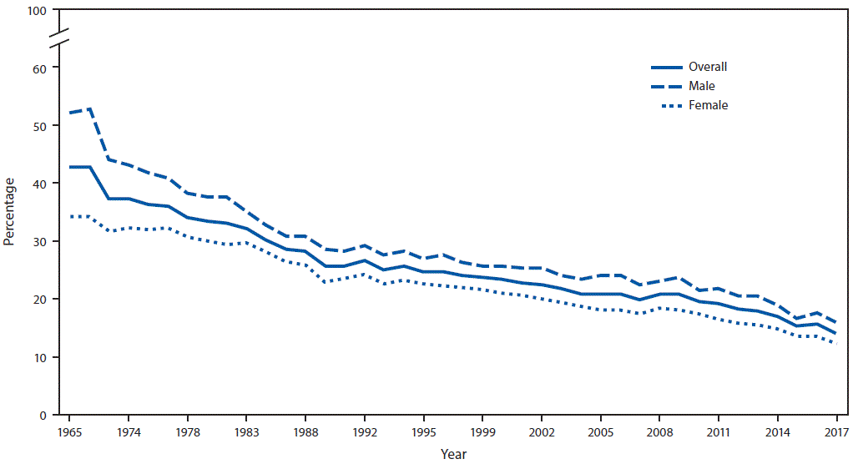
Overall, Tobacco use is Decreasing
Notes:
CDC data for US adults
https://www.cdc.gov/mmwr/volumes/67/wr/mm6744a2.htm

Slide 6
NYTS (National Youth Tobacco Survey) Prevalence (% of HS)
Notes:
Cigarette use is also decreasing for youth, but e-cigarette use has greatly increased in the past few years
https://www.cdc.gov/tobacco/data_statistics/surveys/nyts/index.htm

Slide 7
Percentage of [COUNTY] students who used an electronic vapor product during the past 30 days
Compared to other Counties in Michigan:
Notes:
Change graphics to be county-specific using MiPHY: https://mdoe.state.mi.us/schoolhealthsurveys/ExternalReports/CountyReportGeneration.aspx

Slide 8
Among students who used electronic vapor products in past 30 days, the percentage who usually…
Notes:
2017-2018 data
Change graphics to be county-specific using MiPHY: https://mdoe.state.mi.us/schoolhealthsurveys/ExternalReports/CountyReportGeneration.aspx

Slide 9
[Any other local level data]

Slide 10
Key policy changes
Including e-cigarettes in Clean Indoor Air Laws
Adapting to Tobacco 21

Slide 11
Including E-cigarettes in Clean Indoor Air Laws

Slide 12
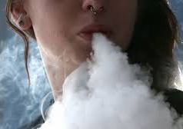
E-Cigarette Use Create Airborne Hazards
E-cigarette vapor is not just “water vapor”
The vapor contains chemicals which can cause harm
Less chemicals than traditional cigarettes, but still a concern
Bystanders should have the option to not be exposed to secondhand vapor
Notes:
Sources:
Secondhand Exposure to Vapors From Electronic Cigarettes
https://doi.org/10.1093/ntr/ntt203
Particulate Matter from Electronic Cigarettes and Conventional Cigarettes: a Systematic Review and Observational Study
https://doi.org/10.1007/s40572-015-0072-x
Use of electronic cigarettes (e-cigarettes) impairs indoor air quality and increases FeNO levels of e-cigarette consumers
https://doi.org/10.1016/j.ijheh.2013.11.003
Cigarettes vs. e-cigarettes: Passive exposure at home measured by means of airborne marker and biomarkers
https://doi.org/10.1016/j.envres.2014.09.005

Slide 13
Known Chemicals in E-Cigarette Vapor
Nicotine
Affects nearly all parts of the body, especially brain because it is addictive
Fine and particles
Can lead to premature death, difficulty breathing, and make heart conditions worse
Other chemicals and toxins including:
Formaldehyde*
Acetaldehyde*
Acrolein
Volatile organic compounds
Heavy metals like nickel* and lead*
*Known to cause cancer
Notes:
Particulate Matter from Electronic Cigarettes and Conventional Cigarettes: a Systematic Review and Observational Study
https://doi.org/10.1007/s40572-015-0072-x
Harmful effects of nicotine
https://www.ncbi.nlm.nih.gov/pmc/articles/PMC4363846/
https://e-cigarettes.surgeongeneral.gov/knowtherisks.html
https://www.epa.gov/pm-pollution/health-and-environmental-effects-particulate-matter-pm
Use of electronic cigarettes (e-cigarettes) impairs indoor air quality and increases FeNO levels of e-cigarette consumers
https://doi.org/10.1016/j.ijheh.2013.11.003
https://www.lung.org/blog/another-gross-reason
Campaign for Tobacco-Free Kids. 2020. “Electronic Cigarettes Should Be Included in Smoke-Free Laws”. https://www.tobaccofreekids.org/assets/factsheets/0387.pdf
Impact of Electronic Cigarettes on the Cardiovascular System
https://doi.org/10.1161/JAHA.117.006353

Slide 14
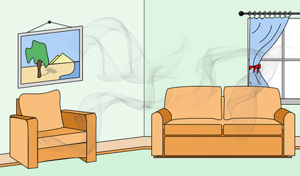
Secondhand Vapor
Vaping also effects non-users, especially indoors
Nicotine and other chemicals have been found in non-users
E-cigarettes can also be a source of thirdhand exposure to nicotine via surfaces
It is unclear what the effects of such exposure is, especially among vulnerable groups like:
Children
Pregnant women
Individuals with cardiovascular disease
Notes:
A team of researchers from Spain, Ballbè et al found “non-smokers passively exposed to e-cigarettes absorb nicotine”
Sources:
Cigarettes vs. e-cigarettes: Passive exposure at home measured by means of airborne marker and biomarkers
https://doi.org/10.1016/j.envres.2014.09.005
Secondhand Exposure to Vapors From Electronic Cigarettes
https://doi.org/10.1093/ntr/ntt203
Electronic Cigarettes Are a Source of Thirdhand Exposure to Nicotine
https://doi.org/10.1093/ntr/ntu152
Impact of Electronic Cigarettes on the Cardiovascular System
https://doi.org/10.1161/JAHA.117.006353

Slide 15
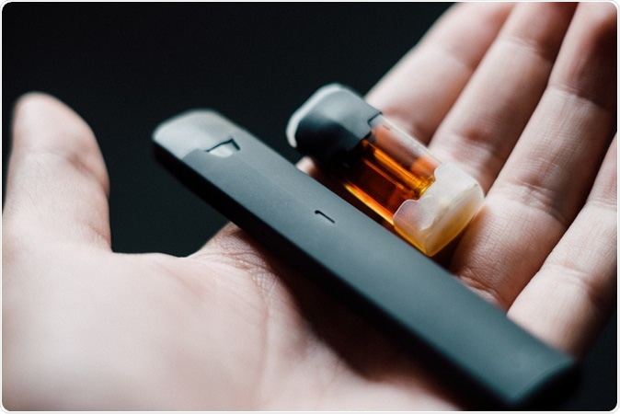
More Research Is Needed
Notes:
There are still many unanswered questions about the health effects of e-cigarettes as they have only been sold for about a decade. (Sales started in 2007 and in 2010 is when the products really started gaining in popularity)
Sources:
https://e-cigarettes.surgeongeneral.gov/documents/2016_SGR_Full_Report_non-508.pdf
Secondhand Exposure to Vapors From Electronic Cigarettes
https://doi.org/10.1093/ntr/ntt203
Particulate Matter from Electronic Cigarettes and Conventional Cigarettes: a Systematic Review and Observational Study
https://doi.org/10.1007/s40572-015-0072-x
Use of electronic cigarettes (e-cigarettes) impairs indoor air quality and increases FeNO levels of e-cigarette consumers
https://doi.org/10.1016/j.ijheh.2013.11.003
Cigarettes vs. e-cigarettes: Passive exposure at home measured by means of airborne marker and biomarkers
https://doi.org/10.1016/j.envres.2014.09.005
https://www.news-medical.net/news/20190131/Vaping-twice-as-good-as-gum-for-quitting-smoking-finds-study.aspx

Slide 16
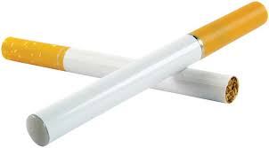
Ensuring Success of Smoke-Free Laws
Can you spot the difference?
Notes:
Campaign for Tobacco-Free Kids. 2020. “Electronic Cigarettes Should Be Included in Smoke-Free Laws”. https://www.tobaccofreekids.org/assets/factsheets/0387.pdf

Slide 17
Ensuring Success of Smoke-Free Laws
Can you spot the difference?
Including e-cigarettes and other vapor products reduces burden on businesses to distinguish between products
Notes:
Campaign for Tobacco-Free Kids. 2020. “Electronic Cigarettes Should Be Included in Smoke-Free Laws”. https://www.tobaccofreekids.org/assets/factsheets/0387.pdf

Slide 18
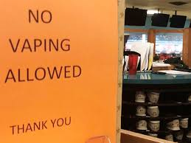
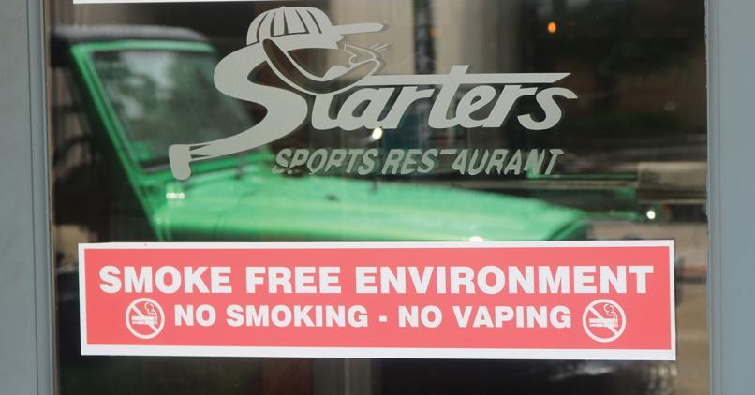
Ensuring Success of Smoke-Free Laws
Creates an environment where cessation is more likely, and initiation is less likely
Notes:
https://www.thepublicopinion.com/news/local_news/public-vaping-ban-passed-in-s-d-amid-some-controversy/article_071a30da-7c1f-5ca2-bdaa-fde05e9c3128.html
https://www.mingomessenger.com/news/article_fb8f798e-a1a2-11ea-a273-135462f20729.html

Slide 19
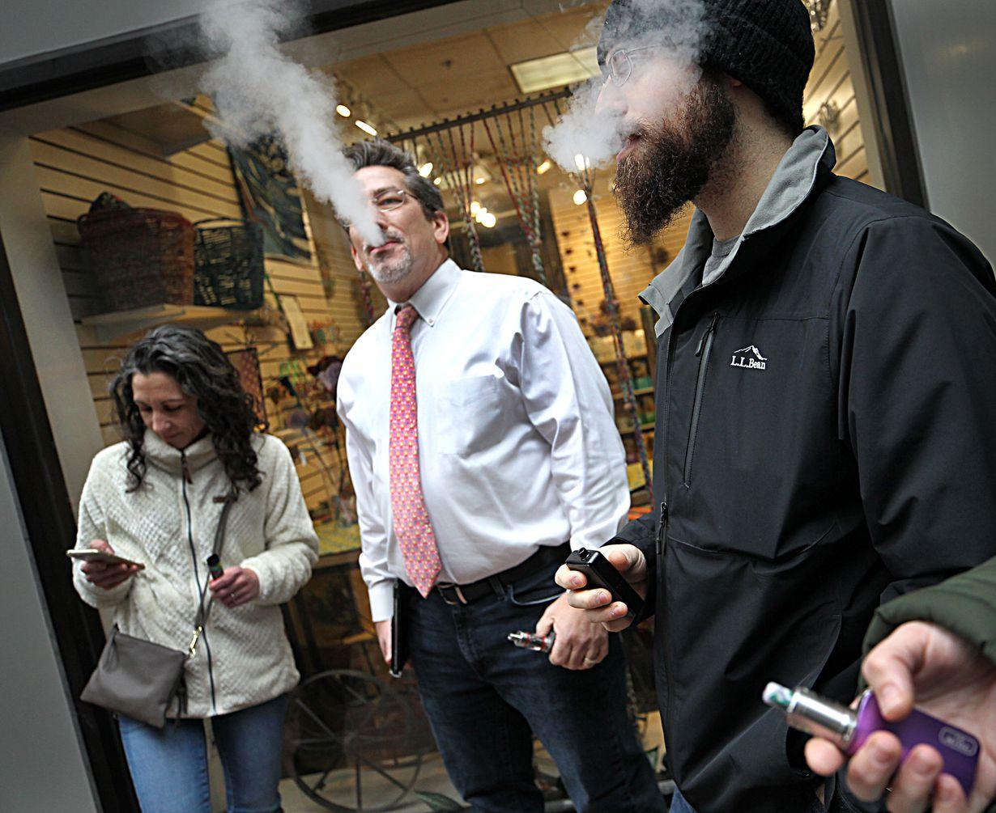
Does not infringe on the rights of legal users of vapor products
Vaping can still be done outside (with the exception of school property)
Notes:
https://www.bostonglobe.com/metro/2019/11/22/you-are-essentially-condemning-packed-hearing-baker-administration-hears-from-smokers-vape-sales-ban/aunRDNgZ7T7iMbCELagfeP/story.html
https://www.rgj.com/story/news/2020/07/10/nevada-public-health-officials-ask-businesses-implement-voluntary-smoking-vaping-bans/5416077002/
https://abc11.com/vaping-vape-no-at-school/5485179/

Slide 20
E-Cigarettes Should be Included in All Tobacco Policies
E-cigarettes are not risk-free
There is mixed evidence on whether e-cigarettes are an effective cessation aid
Comprehensive policies go beyond just e-cigarettes and are needed to protect against emerging products and close loopholes
Notes:
Sources:
“E-Cigarettes: Use, Effects on Smoking, Risks, and Policy Implications”
https://doi.org/10.1146/annurev-publhealth-040617-013757
“E-Cigarettes and Cardiovascular Disease Risk: Evaluation of Evidence, Policy Implications, and Recommendations”
https://doi.org/10.1007/s12170-016-0505-6
U.S. Preventive Services Task Force, Behavioral and Pharmacotherapy Interventions for Tobacco Smoking Cessation in Adults, Including Pregnant Women: U.S. Preventive Services Task Force Recommendation Statement, 163 Annals of Internal Medicine (2015), http://www.uspreventiveservicestaskforce.org/Page/Document/UpdateSummaryFinal/tobacco-use-in-adults-and-pregnant-women-counseling-and-interventions1.
Brian King, et al., Awareness and Ever Use of Electronic Cigarettes Among U.S. Adults, 2010-2011, 15 Nicotine & Tobacco Research 1623 (2013). See also, Brian King et al., Trends in Awareness and Use of Electronic Cigarettes among U.S. Adults, 2010-2013, 17 Nicotine & Tobacco Research 219 (2014).
Samane Zare et al., A systematic review of consumer preference for e-cigarette attributes: Flavor, nicotine strength, and type, 13 PLoS One. 1 (2018) Mar 15; https://doi.org/10.1371/journal.pone.0194145
CDC, QuickStats: Cigarette Smoking Status Among Current Adult E-cigarette Users, by Age Group — National Health Interview Survey, United States, 2015, 65 MMWR 1177 (October 28, 2016), https://www.cdc.gov/mmwr/volumes/65/wr/mm6542a7.htm. See also CDC, About Electronic Cigarettes (E-Cigarettes), https://www.cdc.gov/tobacco/basic_information/e-cigarettes/about-e-cigarettes.html#who-is-using-e-cigarettes

Slide 21
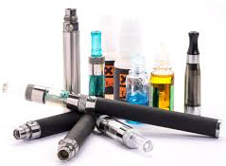
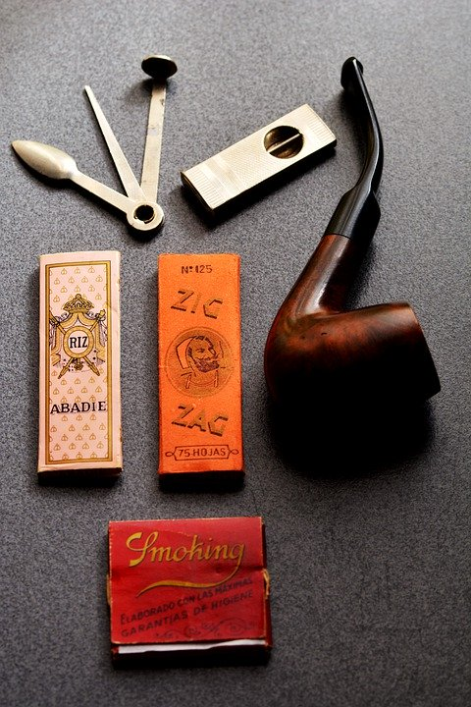
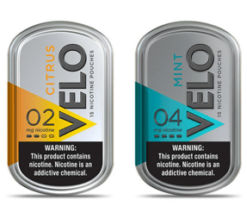
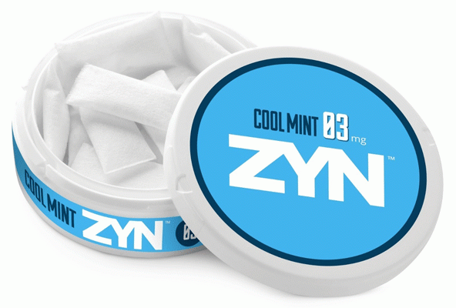
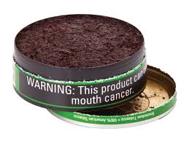
Covering Tobacco Comprehensively
Conventional Tobacco Products
Tobacco Product Paraphernalia
Vapor Products
Alternative Nicotine Products
Notes:
Conventional tobacco products (cigarettes, cigars, chewing tobacco, etc.)
Tobacco product paraphernalia (pipes, rolling paper, electronic devices, etc.)
Vapor products (e-cigarettes, vape juice, reusable devices, disposable products, etc.)
Alternative nicotine products
▪ Some manufactured by tobacco companies, some manufactured by pharmaceutical companies
▪ All do not contain tobacco, only nicotine
• Advertised as tobacco-free, but regulated as tobacco products
• Slower delivery of nicotine than e-cigarettes
▪ Very similar to smokeless tobacco
▪ Came from snus (Swedish)
▪ Add flavors to create taste (otherwise there is no flavor)
▪ Currently a small part of the market, but growing
▪ No premarket approval
Definitions in SFELP model policy for reference:
2-3 Tobacco Product – Shall mean any product that is made from or derived from tobacco, and is intended for human consumption or is likely to be consumed, whether smoked, heated, chewed, absorbed, dissolved, inhaled or ingested by any other means, including, but not limited to, a cigarette, a cigar, pipe tobacco, chewing tobacco, snuff, snus, or any other smokeless tobacco. The term also includes vapor products and alternative tobacco products. The term also includes tobacco product paraphernalia, whether or not they contain nicotine. Tobacco product does not include drugs, devices, or combination products authorized for sale by the U.S. Food and Drug Administration, as those terms are defined in the Federal Food, Drug and Cosmetic Act.
2-4 Tobacco Product Paraphernalia – Shall mean any product that is used to assist in chewing, smoking, absorbing, dissolving, inhaling, or any other consumption of tobacco to include, but not limited to pipes, rolling papers, and electronic smoking devices.
2-5 Vapor Product – Shall mean a noncombustible product that employs a heating element, power source, electronic circuit, or other electronic, chemical, or mechanical means, regardless of shape or size, that can be used to produce vapor from nicotine or any other substance, and the use or inhalation of which simulates smoking. Vapor product includes an electronic cigarette, electronic cigar, electronic cigarillo, electronic pipe, or similar product or device and a vapor cartridge or other container of nicotine or other substance in a solution or other form that is intended to be used with or in an electronic cigarette, electronic cigar, electronic cigarillo, electronic pipe, or similar product or device. Vapor product does not include a product regulated as a drug or device by the United States Food and Drug Administration under 21 USC 351 to 360fff-7.
2-6 Alternative Nicotine Product – Shall mean a noncombustible product containing nicotine that is intended for human consumption, whether chewed, absorbed, dissolved, or ingested by any other means. Alternative nicotine product does not include a tobacco product, a vapor product, food, or a product regulated as a drug or device by the United States Food and Drug Administration under 21 USC 351 to 360fff-7.

Slide 22
Adapting to Tobacco 21

Slide 23
What are Tobacco 21 laws?
Limits minimum age of sale of tobacco products to 21 or older
Can change who enforces and who is the enforcement target of such laws
Notes:
Tobacco 21 (T21) policies aim to reduce youth access to tobacco products (including cigarettes, e-cigarettes and any other tobacco products) as well as tobacco paraphernalia by restricting sales to people aged 21 or over. There is some debate over whether T21 encompasses laws that change the minimum age of purchase. T21 policies can also change who enforces and who is the enforcement target of such laws

Slide 24
Federal: Tobacco 21
Passed in late December 2019
Includes all nicotine and tobacco products
Nation-wide, no longer patchwork policy
Effectiveness depends on states and localities
Notes:
Means that those under 21 can no longer drive to a nearby town or state to purchase tobacco products.
“As of December 20, 2019, the federal age to purchase all tobacco and nicotine products is 21 years old. This means that it is now a violation of federal law for any retailer to sell any nicotine or tobacco products to anyone under the age of 21. The US Food and Drug Administration (FDA) is tasked with enforcing the law.”
https://www.aap.org/en-us/advocacy-and-policy/aap-health-initiatives/Richmond-Center/Pages/Tobacco-21.aspx
https://countertobacco.org/policy/tobacco-21/
https://tobacco21.org/federal-tobacco-21-faq/

Slide 25
State Action
Senate Bills 781-786
(currently being considered)
Among other initiatives, this set of bills proposes measures which will increase compliance with the new federal minimum age of sale
Aligns Michigan law with the new federal law and emphasizes need to comply
Similar measures at the local level can improve compliance as well
Notes:
https://tobacco21.org/federal-tobacco-21-faq/

Slide 26
Data supports Tobacco 21 policy
Nicotine affects youth brain development
Many tobacco users started before age 18
Local Tobacco 21 decreases use among 18-20-year-olds
Many retailers support increasing the age and comply
Notes:
Since the IOM report even more studies have shown why it is important to increase the age of sale for all tobacco to 21
Also it has been noted retailers comply with other youth access interventions
Sources:
“Evaluation of California’s ‘Tobacco 21’ law”
http://dx.doi.org/10.1136/tobaccocontrol-2017-054088
Do Local Tobacco-21 Laws Reduce Smoking Among 18 to 20 Year-Olds?
https://doi.org/10.1093/ntr/ntz123
Use of tobacco retail permitting to reduce youth access and exposure to tobacco in Santa Clara County, California”
https://doi.org/10.1016/j.ypmed.2014.01.023
Unique, long-term effects of nicotine on adolescent brain
Pharmacol Biochem Behav. 2020 Jul 29;173010. Online ahead of print.
Frances M Leslie
https://www.sciencedirect.com/science/article/pii/S0091305720302185
Delay initiation and reduce tobacco use
https://www.aap.org/en-us/advocacy-and-policy/aap-health-initiatives/Richmond-Center/Pages/Tobacco-21.aspx
https://countertobacco.org/policy/tobacco-21/
https://truthinitiative.org/research-resources/tobacco-prevention-efforts/where-we-stand-raising-tobacco-age-21
2018 SG Report

Slide 27
Enforcement
Decriminalization and Working With the Community

Slide 28
Federal and State: Sales to Minors in the Past Year
FDA Compliance Check Inspections
Violation rate: 18% (out of 1423)
258 sold to minors
2019 Synar Report
Violation rate: 9.9% (out of 353)
35 sold to minors
33 sold cigarettes
1 cigar, 1 smokeless tobacco sale
No ENDS reported as sold to minors
Notes:
https://www.accessdata.fda.gov/scripts/oce/inspections/oce_insp_searching.cfm
These are the violation rates in Michigan showing that there is an opportunity to reduce sales to children further. Please update before using.
In some cities violations much higher than others, Dearborn had 40% failure rate.

Slide 29
[Local Data on Violations/Compliance]

Slide 30
Improving Enforcement
Effective: high level of compliance needed to deliver health benefits
Comprehensive: cover all products, license all premises and events
Civil: limit enforcement by police to avoid exacerbating inequalities
Tobacco laws require an effective, comprehensive and civil enforcement
Notes:
A University of Michigan project found T21 laws require an effective, comprehensive and civil enforcement and compliance regime to function properly.
By effective we mean the policy needs to be followed by all tobacco retailers. As the wellspring of tobacco products in their communities retailers must face incentives to comply with the law that align with public health objectives. A system must be in put in place such that fines inflicted on a retailer or clerk are not the cost of doing business when selling tobacco products to under aged customers, but rather act as measures to actually change retailer practices. Comprehensive policies must cover all products and paraphernalia, all retailers be they temporary or permanent and all events where tobacco products or paraphernalia are sold. Civil refers to limiting enforcement by the police and instead relying on food inspections or sanitarians to conduct inspections as well as taking the punishment for underage sales from the criminal to the civil realm. This means doing away with prohibitions on youth tobacco purchase use and possession.
[Cite IHPI policy sprint and related paper]

Slide 31
Decriminalization of Youth Access to Tobacco
Must shift from criminal penalties on minors to civil punishment for retailers
Creates an investment in the future of local youth by reducing access to tobacco and removing criminal charges associated with tobacco possession
Notes:
Also from the University of Michigan project

Slide 32
Why Focus on Retailers?
Purchase, use, and/or possession (PUP) laws can be unfair
Punishment varies (Fines, mandatory education, restrictions on driving, community service)
Youth of color more likely to be targeted, could lead to disastrous consequences
Examples: bodily harm, mental distress, and lost economic and educational opportunities
Elijah Tufono
Notes:
Unfortunately, there was an incident earlier this year (April 2020) in California involving the 14-year-old boy pictured here, Elijah, where a police officer “forcibly detained” him over possession of a cigar. Elijah and his family are now speaking out about this incident It is important to be mindful that these situations happen and could be prevented.
Additional info:
Multiple violations often invoke escalating penalties, including fines, mandatory education, restrictions on driving, and community service
Enforcement varies across communities: most happens at the local level and is often unfunded
Collateral consequences can include bodily harm, mental distress, and lost economic and educational opportunities
People of color are disproportionately affected
Evidence of the impact of PUP laws on youth tobacco use is mixed
Some studies have found evidence that it creates a deterrent effect among youth
Other studies have questioned the effectiveness, especially within communities of color from a health equity focus
Sources:
https://www.dailymail.co.uk/news/article-8267635/Shocking-video-shows-California-cop-slamming-14-year-old-boys-face-body-pavement.html
https://www.nydailynews.com/news/national/ny-video-shows-cop-punching-fourteen-year-old-pinning-him-to-ground-20200429-ortcockoxbetferemsraysn5zi-story.html
4. Tworek, Cindy, Gary Giovino, K. Michael Cummings, Andrew Hyland and Frank J. Chaloupka. 2011. Youth Access Tobacco Possession, Use and Purchase Laws: Measures of State and Local Enforcement. ImpacTeen Research Paper No. 41. Chicago: University of Illinois at Chicago.
5. IOM. 2015. Health Implications of Raising the Minimum Age for Purchasing Tobacco Products. March. http://www.nationalacademies.org/hmd/Activities/PublicHealth/TobaccoMinimumAge.aspx
6. Jason LA, Pokorny SB, Schoeny ME. Evaluating the effects of enforcements and fines on youth smoking. Critical Public Health. 2003 Mar 1;13(1):33-45.
7. Jason LA, Pokorny SB, Adams M. A randomized trial evaluating tobacco possession-use-purchase laws in the USA. Social Science & Medicine. 2008 Dec 1;67(11):1700-7.
8. Pokorny SB, Adams M, Jason L. Randomized Trial Evaluating Tobacco Possession-Use-Purchase Laws in the USA. Social science & medicine (1982). 2008 Dec;67(11):1700.
9. Jason LA, Pokorny SB, Adams M, Topliff A, Harris C, Hunt Y. Youth tobacco access and possession policy interventions: Effects on observed and perceived tobacco use. American Journal on Addictions. 2009 Aug 10;18(5):367-74.
10. Gottlieb NH, Loukas A, Corrao M, McAlister A, Snell C, Huang PP. Minors’ tobacco possession law violations and intentions to smoke: Implications for tobacco control. Tobacco control. 2004 Sep 1;13(3):237-43.
11. Ross H, Chaloupka FJ. The effect of cigarette prices on youth smoking. Health economics. 2003 Mar;12(3):217-30.
12. Tworek C, Yamaguchi R, Kloska DD, Emery S, Barker DC, Giovino GA, O’Malley PM, Chaloupka FJ. State-level tobacco control policies and youth smoking cessation measures. Health Policy. 2010 Oct 1;97(2-3):136-44.
13. Tworek, C, Giovino G, Cummings KM, Hyland A, Chaloupka FJ. 2011. Youth Access Tobacco Possession, Use and Purchase Laws: Measures of State and Local Enforcement. ImpacTeen Research Paper No. 41. Chicago: University of Illinois at Chicago. December. https://tobacconomics.org/research/youth-access-tobacco-possession-use-and-purchase-laws-measures-of-state-and-local-enforcement/
14. Naya Family Center. 2017. A Policy to Increase the Minimum Legal Sales Age for Tobacco and Nicotine Products from 18 to 21: Health Equity Implications. T21 Policy Health Equity Impact Assessment Technical Report. June. https://multco.us/file/64396/download
The Merchants, Not the Customers: Resisting the Alcohol and Tobacco Industries’ Strategy to Blame Young People for Illegal Alcohol and Tobacco Sales
https://doi.org/10.2307/3342619

Slide 33
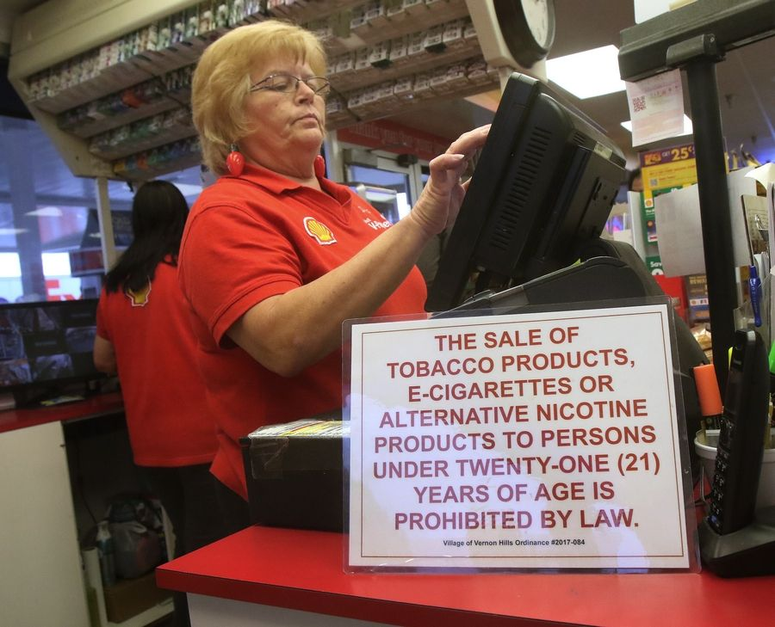
Civil Fines on Retailers are Effective
Fines for retailers selling to youth is more effective than education about reducing sales to youth
In Chicago illegal sales were decreased from 86% to 42% at least by increasing enforcement combined with civil penalties
Notes:
Sources:
Reducing the Illegal Sales of Cigarettes to Minors: Analysis of Alternative Enforcement Schedules
https://doi.org/10.1901/jaba.1996.29-333
The Merchants, Not the Customers: Resisting the Alcohol and Tobacco Industries’ Strategy to Blame Young People for Illegal Alcohol and Tobacco Sales
https://doi.org/10.2307/3342619
Regulating the tobacco retail environment: beyond reducing sales to minors
http://dx.doi.org/10.1136/tc.2009.031724

Slide 34
Prevention and Treatment
Educating and Engaging With Community

Slide 35
Education Requirement Included
[CITY or COUNTY] wants the community to be involved and on-board
Includes presentations to public and retailers
Chance for community-driven change
Ensuring needs of community are understood and being met
Clear communication will improve enforcement
Notes:
https://www.columbus.gov/publichealth/programs/Tobacco-21/Download-the-Tobacco-21-Sign/
Opportunity to build relationship with retailers and keep in mind their position in communities and the vulnerability of their staff as well to penalties

Slide 36
Evidence-Based Education
E-cigarette use may lead to uptake of cigarette smoking (but this is not confirmed)
Information about tobacco and vaping cessation resources important
Peer use can influence use by others
Notes:
Spindle, Tory R, Hiler, Marzena M, Cooke, Megan, Eissenberg, Thomas, Kendler, Kenneth S, & Dick, Danielle. (2016). Electronic Cigarette Use and Uptake of Cigarette Smoking: A Longitudinal Examination of U.S. College Students. Addictive Behaviors, 67, 66–72. Journal Article, England: Elsevier Ltd.
Michael Windle, Regine Haardörfer, Steven A. Lloyd, Bruce Foster & Carla J. Berg (2017) Social Influences on College Student Use of Tobacco Products, Alcohol, and Marijuana, Substance Use & Misuse, 52:9, 1111-1119, DOI: 10.1080/10826084.2017.1290116
Hart, E. P., Sears, C. G., Hart, J. L., & Walker, K. L. (2017). Electronic Cigarettes and Communication: An Examination of College Students' Perceptions of Safety and Use. Kentucky journal of communication, 36(1), 35–51.
Trumbo, C. W., & Harper, R. (2016). A Comparison of Students and Non-Students with Respect to Orientation Toward E-cigarettes. Journal of public health research, 5(2), 595. https://doi.org/10.4081/jphr.2016.595

Slide 37
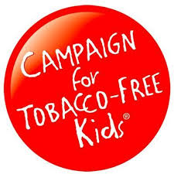
Sources for Evidence-Based Education
Information is available from the following reputable organizations:

Slide 38
Summary
Including e-cigarettes in smoke-free policies will:
Ensure safe, clean indoor air
Increase success of the existing policy
Create a comprehensive tobacco policy
Raising the age of sale to 21 will:
Protect youth and future health
Improved enforcement and education will:
Increase compliance and success of the passed policy

Slide 39
This is an opportunity to work with our community to identify needs and a comprehensive approach to youth tobacco use
Support passage of a “Regulation to Prohibit the Sale of Tobacco Products to Individuals Under 21 Years of Age, and to Prohibit the Use of Tobacco Products in Smoke-Free Places” as a step toward better community health

Slide 40
Questions?

Slide 41
Supplemental Materials

Slide 42
MiPHY (Michigan Profile for Healthy Youth)
Voluntary survey completed by 7, 9, and 11th grade students in Michigan
Database: https://mdoe.state.mi.us/schoolhealthsurveys/ExternalReports/CountyReportGeneration.aspx
Notes:
MiPHY can provide local information to know where [CITY OR COUNTY] stands in relation to the rest of Michigan

Slide 43
SFELP Can Help!
SFELP has created:
A model policy
Educational materials (decision makers and community)
Reach out for help:
Finding resources
Reviewing policy
Creating written materials (one pager, testimony)

Slide 44
Enforcement & Compliance: Federal
Federal requirements for MI to conduct compliance checks:
As contractor for the FDA under the Tobacco Control Act of 2009
To SAMHSA in exchange for block grant funding (Synar program)
Oversight by State department working with PIHPs using a Master Retailer List (every 3 years this list is checked to ensure all retailers are covered)
Differences:
FDA checks cover e-cigarettes and some novel products while Synar (which was enacted nearly 30 years ago) does not necessarily (some states do cover these products)
FDA-issued penalties are focused on premises, not clerks
Synar requires statistical sampling of retailers, FDA does not
Notes:
Background/context for federal vs. Synar compliance checks

Slide 45
Other Parts of the Model Policy
In addition to raising the minimum age the proposed policy also specifies:
Signage requirements
Near point of sale a sign must be posted stating “NO PERSON UNDER THE AGE OF 21 MAY BE SOLD TOBACCO PRODUCTS, INCLUDING VAPOR PRODUCTS.”
[name] County shall provide this notice to ensure consistency across retailers as well as compliance
Identification requirements
Anyone appearing 30 years or younger must show ID
Internet sales must be picked up at a tobacco retailer so age can be confirmed
Policy includes provisions which prohibit:
Vending machines
Distribution of tobacco products at no or minimal cost for promotion purposes
Notes:
Goal to increase comprehensiveness and improve enforcement

